Slide 1
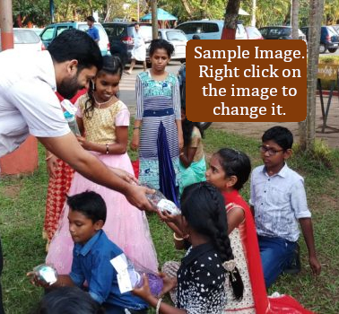
FRATELLI TUTTI
Monday Webinar Series – 5
Faculty of Theology
Dharmaram Vidya Kshetram
Bengaluru – 29
India

Slide 3
THIS IS A SECTION TITLE

Slide 5
THIS IS ANOTHER SECTION TITLE

